Slide 1
EPFL Space Center eSpace
Space Propulsion ENG-510

Slide 2
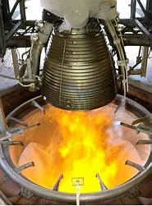
Lecture # 1 Part # 2 Introduction in Propulsion Systems
Brief overview on all space propulsion systems

Slide 3
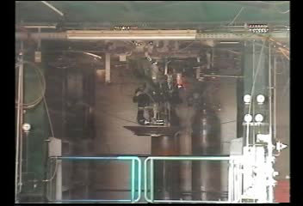
Why is propulsion such interesting (for me)?
L1 – Propulsion Systems
Space Propulsion ENG-510

Slide 4
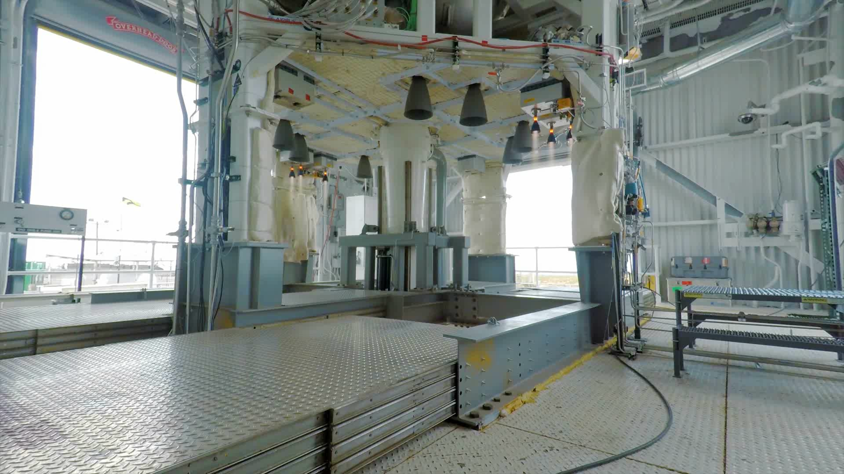
Why is propulsion such interesting (for me)?
L1 – Propulsion Systems
Space Propulsion ENG-510

Slide 5

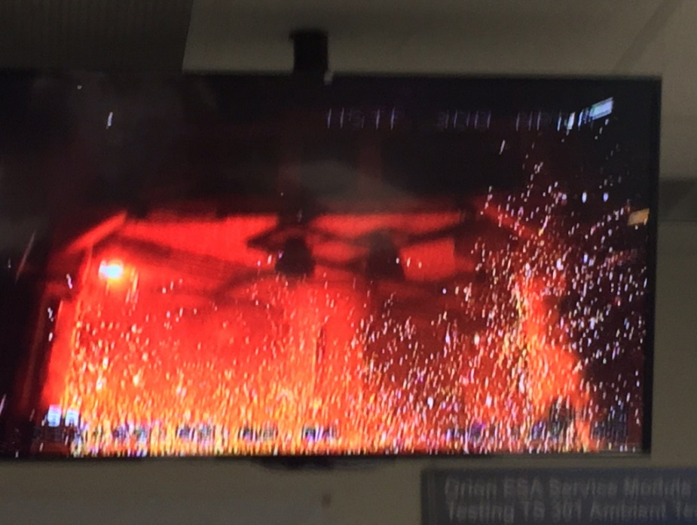
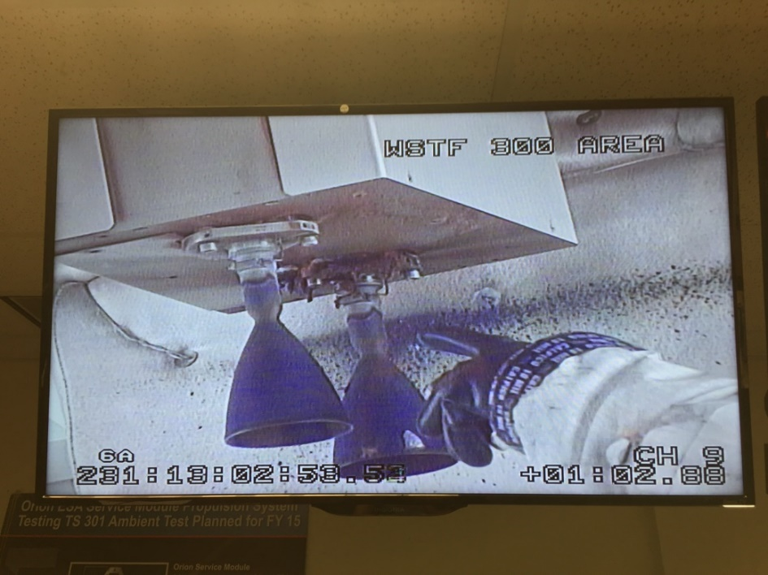

Why is propulsion such interesting (for me)?
5
But also…
L1 – Propulsion Systems
Space Propulsion ENG-510
ZOT

Slide 6
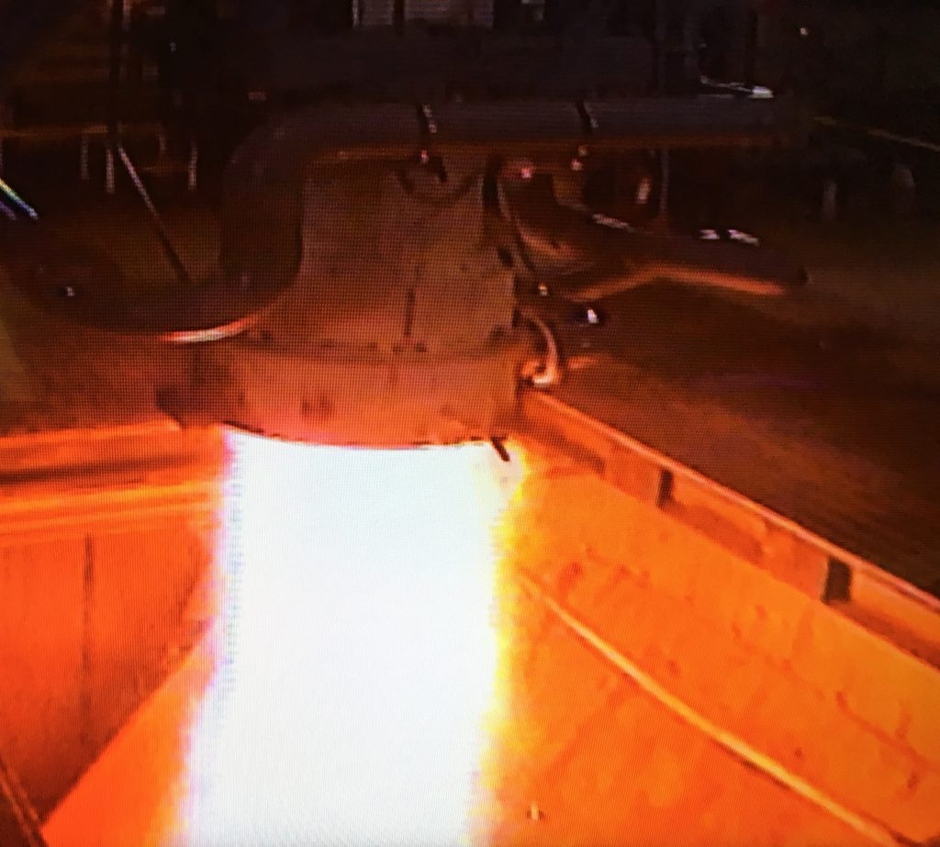
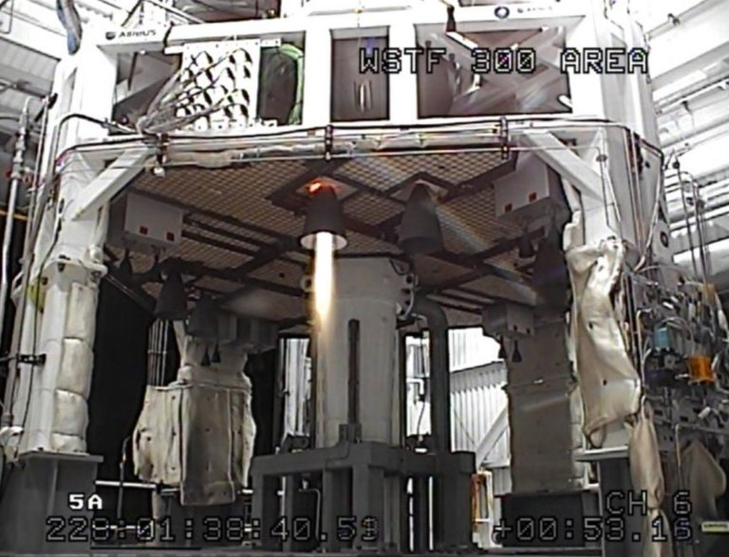
Why is propulsion such interesting (for me)?
Propulsion is loud, hot but also dangerous and difficult!
L1 – Propulsion Systems
Space Propulsion ENG-510

Slide 7
What is the principle of Space Propulsion?
Basic Working Principle for Propulsion:
In its simplest form, a propulsion system accelerates matter to provide a force of thrust that moves or rotates a vehicle
Example: Small row boat on the lake of Geneva
Basic rocket equation (Tsiolkovsky rocket equation): The basis principle of a classical rocket engine is to eject mass with a high velocity. The recoil of this ejection is then increasing the velocity of the Spacecraft (S/C) including the Payload (P/L) as well as the remaining propellant
L1 – Propulsion Systems
Space Propulsion ENG-510

Slide 8
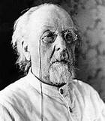
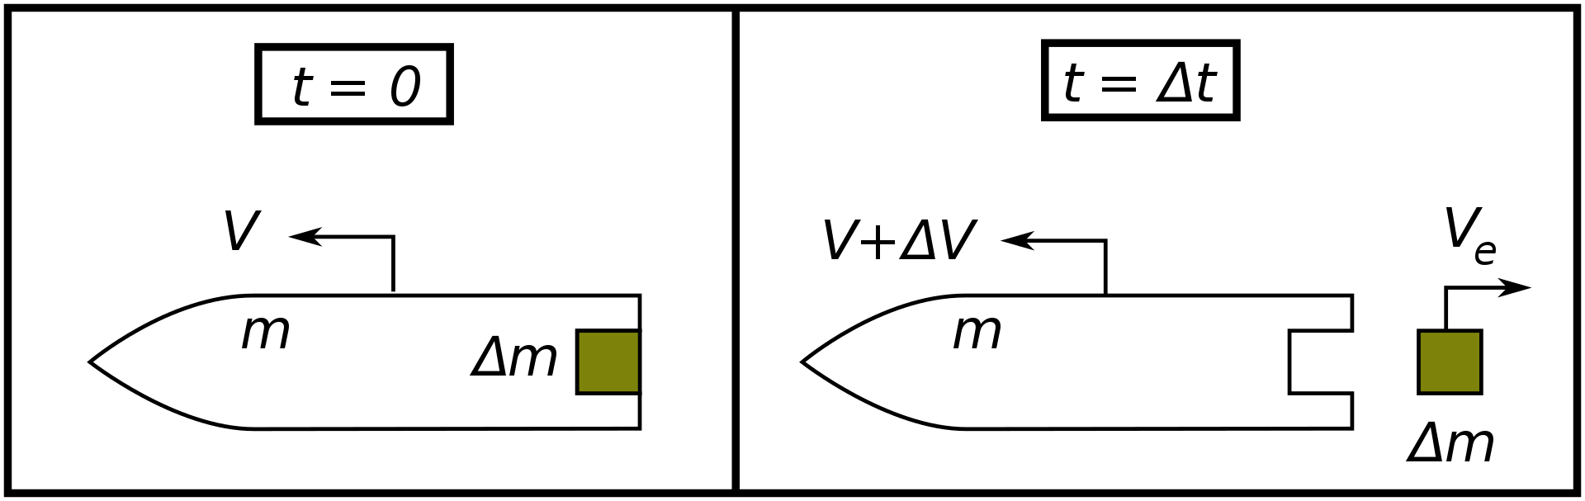

What is the principle of Space Propulsion?
Basic Working Principle for Propulsion:
Basic rocket equation (Tsiolkovsky rocket equation)
$$∆v=v_{e}ln\frac{m_{0}}{m_{1}}$$
L1 – Propulsion Systems
Space Propulsion ENG-510
Konstantin Tsiolkovsky

Slide 9
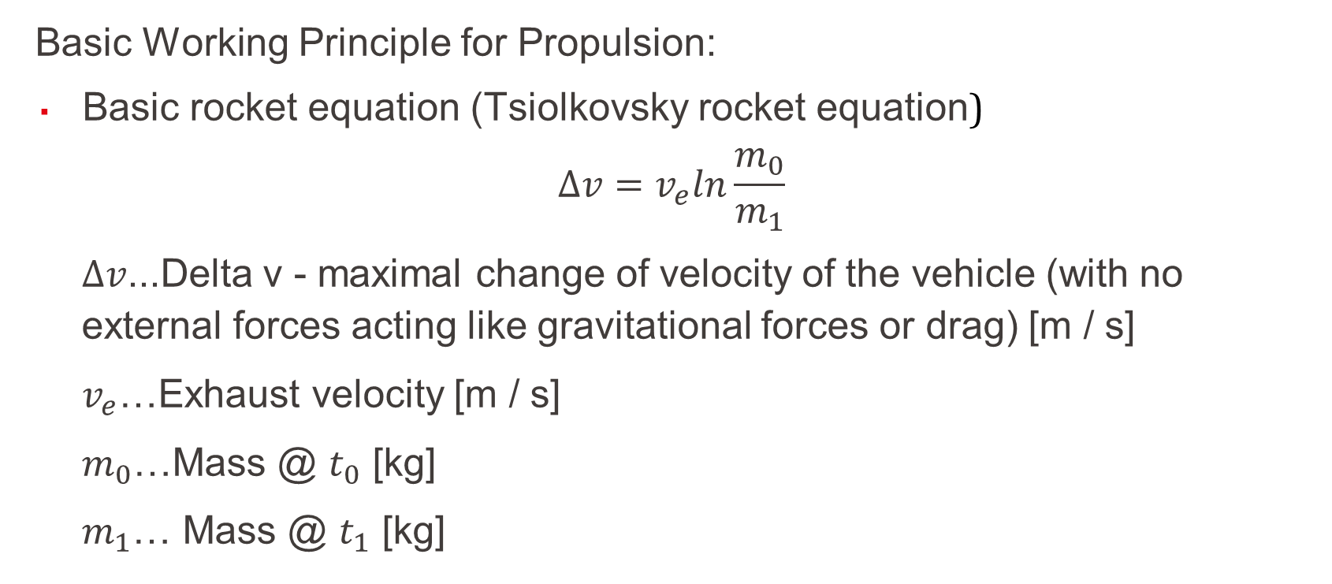
What is the principle of Space Propulsion?
Basic Working Principle for Propulsion:
Basic rocket equation (Tsiolkovsky rocket equation)
$$∆v=v_{e}ln\frac{m_{0}}{m_{1}}$$
$∆v$...Delta v - maximal change of velocity of the vehicle (with no external forces acting like gravitational forces or drag) [m / s]
$v_{e}$…Exhaust velocity [m / s]
$m_{0}$…Mass @ $t_{0}$ [kg]
$m_{1}$… Mass @ $t_{1}$ [kg]
L1 – Propulsion Systems
Space Propulsion ENG-510

Slide 10
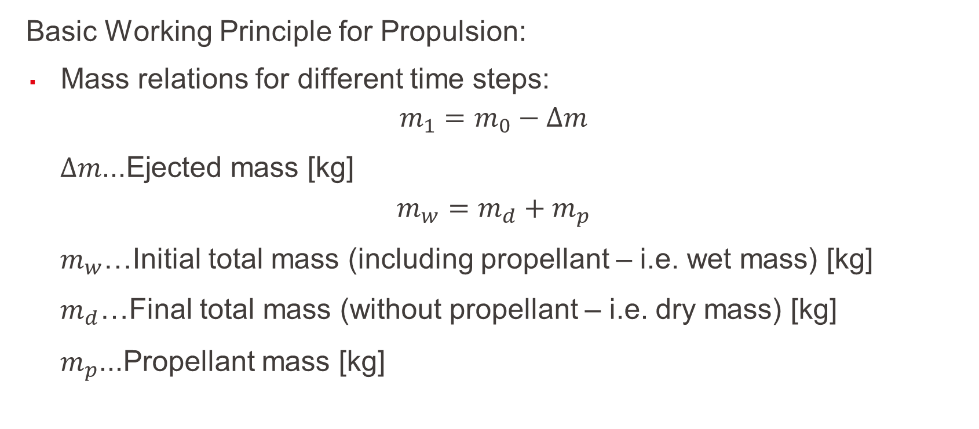
What is the principle of Space Propulsion?
Basic Working Principle for Propulsion:
Mass relations for different time steps:
$$m_{1}=m_{0}−∆m$$
$∆m$...Ejected mass [kg]
$$m_{w}=m_{d}+m_{p}$$
$m_{w}$…Initial total mass (including propellant – i.e. wet mass) [kg]
$m_{d}$…Final total mass (without propellant – i.e. dry mass) [kg]
$m_{p}$...Propellant mass [kg]
L1 – Propulsion Systems
Space Propulsion ENG-510

Slide 11
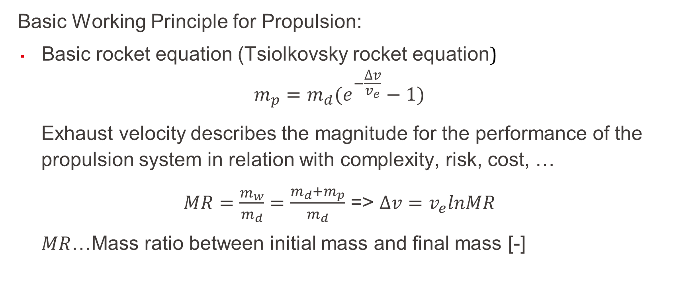
What is the principle of Space Propulsion?
Basic Working Principle for Propulsion:
Basic rocket equation (Tsiolkovsky rocket equation)
$$m_{p}=m_{d}(e^{−\frac{∆v}{v_{e}}}−1)$$
Exhaust velocity describes the magnitude for the performance of the propulsion system in relation with complexity, risk, cost, …
$MR=\frac{m_{w}}{m_{d}}=\frac{m_{d}+m_{p}}{m_{d}}$ => $∆v=v_{e}lnMR$
$MR$…Mass ratio between initial mass and final mass [-]
L1 – Propulsion Systems
Space Propulsion ENG-510

Slide 12
What is the principle of Space Propulsion?
Basic Working Principle for Propulsion:
Performance of orbital maneuvers (small changes of orbit trajectory)
Compensation of perturbations (orbit raising to compensate drag losses)
Long duration burns (for significant Δv increases)
Attitude control (with short, directed thrust (impulse, force push) linked to 3-axis control)
Landing burns (for landing on the Moon)
Lift-off burns requiring high thrust levels
L1 – Propulsion Systems
Space Propulsion ENG-510

Slide 13
What is the principle of Space Propulsion?
Basic Working Principle for Propulsion:
Example: How can we maximize the speed of the row boat on the Water?
Example: What was the problem with the Water rocket failing to reach an orbit respectively the targeted altitude of 100 m?
L1 – Propulsion Systems
Space Propulsion ENG-510

Slide 14
What is important on Δv?
Objective: To understand some specific points on Δv
First one must differ between v and Δv
v is the current velocity of a Spacecraft on his trajectory
v could be constant on a circular orbit or changing permanently on an elliptical orbit (w/o any propulsion)
Δv is the impulse which must be given to a Spacecraft to change the trajectory (e.g. change from elliptical to circular orbit or vice-versa)
L1 – Propulsion Systems
Space Propulsion ENG-510

Slide 15
What is important on Δv?
Objective: To understand some specific points on Δv
Δv is not only resulting from space propulsion systems
Δv is not only velocity change but also orbit change
Δv is not only linked to start point and end point only but also on the way between the two points (orbital trajectory)
Δv is not equal to velocity change
Δv is the same for deceleration and acceleration
L1 – Propulsion Systems
Space Propulsion ENG-510

Slide 16
What is important on Δv?
Objective: To understand some specific points on Δv
Δv is not only resulting from space propulsion systems
Δv is not only velocity change but also orbit change
Δv is not only linked to start point and end point only but also on the way between the two points (orbital trajectory)
Δv is not equal to velocity change
Δv is the same for deceleration and acceleration
L1 – Propulsion Systems
Space Propulsion ENG-510

Slide 17
What is important on Δv?
Objective: To understand some specific points on Δv
Δv is not only resulting from space propulsion systems
Δv changes are also given due to drag forces, gravitational forces, … and similar
Example: ISS is altitude is reduced every day by about 50 to 150 m linked to residual drag forces
L1 – Propulsion Systems
Space Propulsion ENG-510

Slide 18
What is important on Δv?
Objective: To understand some specific points on Δv
Δv is not only resulting from space propulsion systems
Δv is not only velocity change but also orbit change
Δv is not only linked to start point and end point only but also on the way between the two points (orbital trajectory)
Δv is not equal to velocity change
Δv is the same for deceleration and acceleration
L1 – Propulsion Systems
Space Propulsion ENG-510

Slide 19
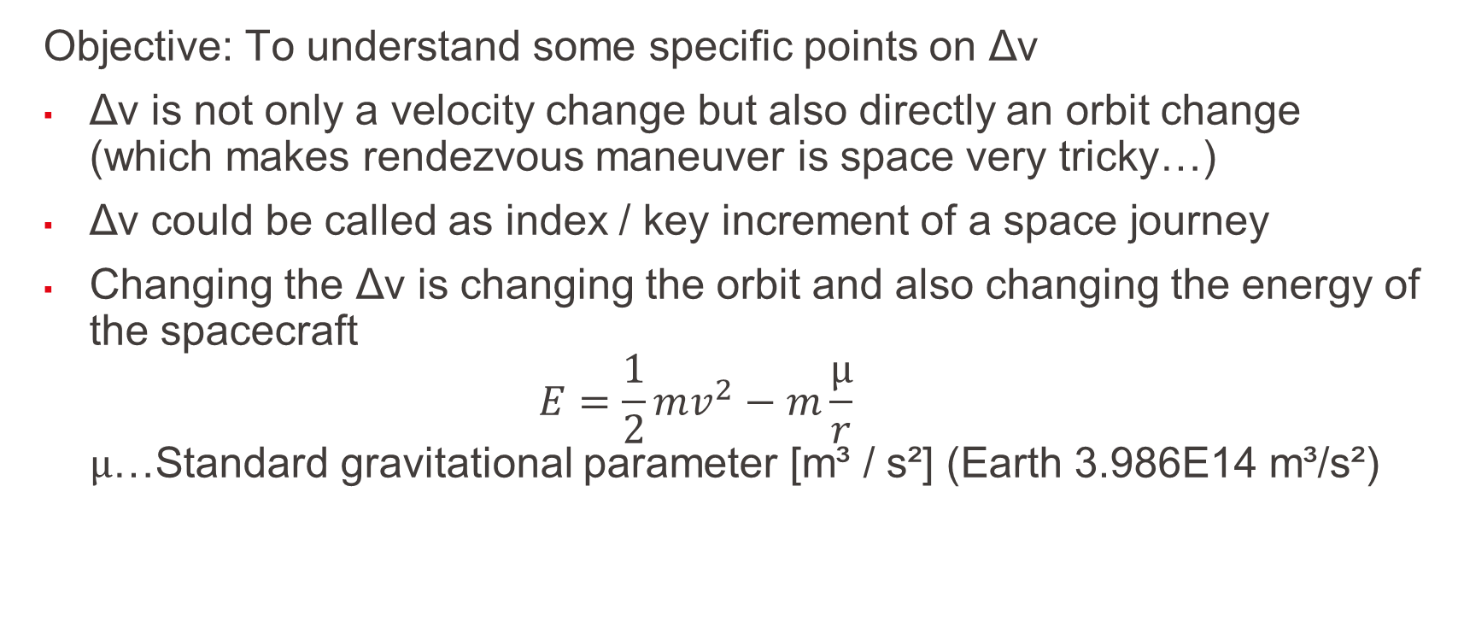
What is important on Δv?
Objective: To understand some specific points on Δv
Δv is not only a velocity change but also directly an orbit change (which makes rendezvous maneuver is space very tricky…)
Δv could be called as index / key increment of a space journey
Changing the Δv is changing the orbit and also changing the energy of the spacecraft $E=\frac{1}{2}mv^{2}−m\frac{μ}{r}$ $μ$…Standard gravitational parameter [m³ / s²] (Earth 3.986E14 m³/s²)
L1 – Propulsion Systems
Space Propulsion ENG-510

Slide 20



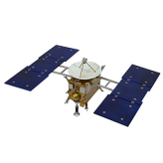



What is important on Δv?
Objective: To understand some specific points on Δv
Important Δv impulse on circular orbit changes the trajectory to an elliptical orbit (assuming escape velocity is not reached) and increasing the energy
L1 – Propulsion Systems
Space Propulsion ENG-510

Slide 21
What is important on Δv?
Objective: To understand some specific points on Δv
On the elliptical orbit the real velocity is permanently changing (as well as radius of flight trajectory) considering the Energy conservation
This velocity change is occurring without any further space propulsion impulse, just linked to the orbital trajectory and the Energy conservation which is described by the vis-viva equation
L1 – Propulsion Systems
Space Propulsion ENG-510

Slide 22
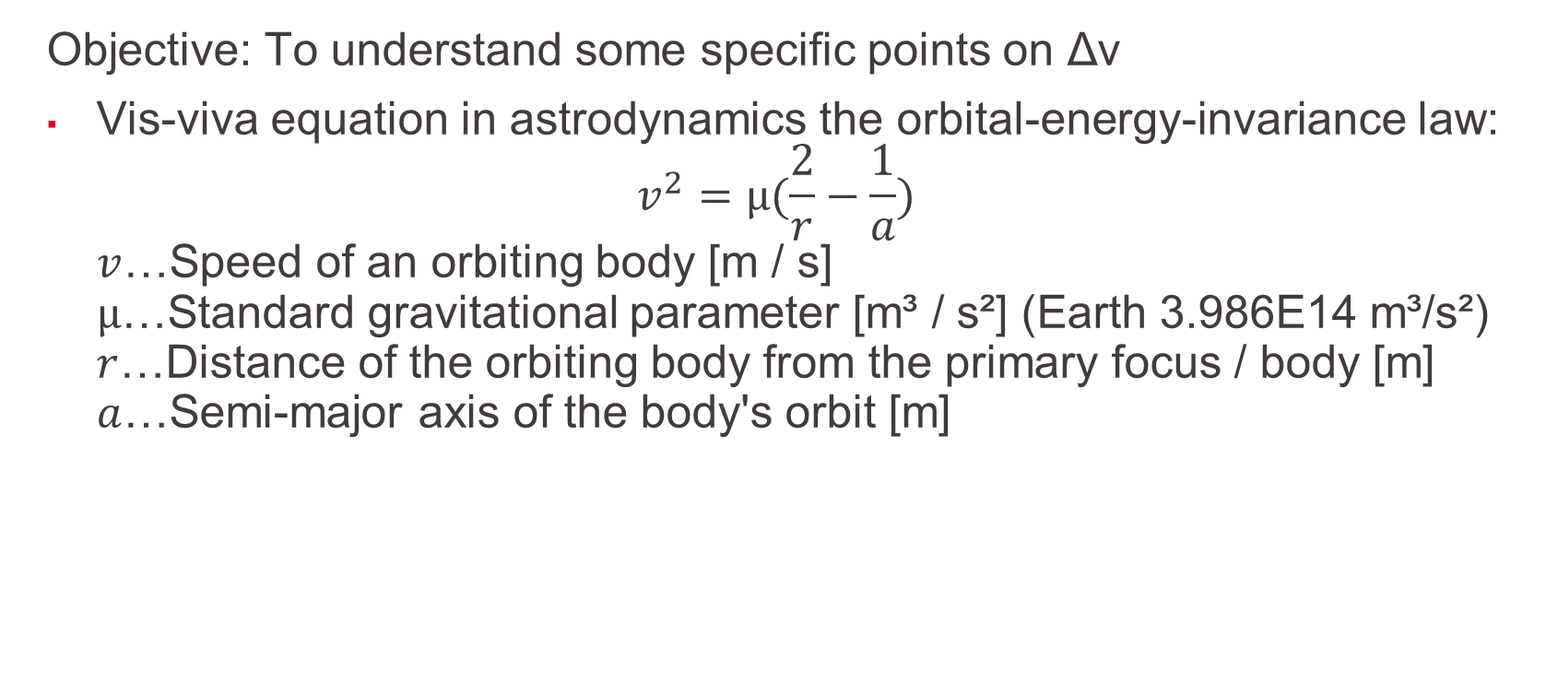
What is important on Δv?
Objective: To understand some specific points on Δv
Vis-viva equation in astrodynamics the orbital-energy-invariance law: $v^{2}=μ(\frac{2}{r}−\frac{1}{a})$ $v$…Speed of an orbiting body [m / s] $μ$…Standard gravitational parameter [m³ / s²] (Earth 3.986E14 m³/s²) $r$…Distance of the orbiting body from the primary focus / body [m] $a$…Semi-major axis of the body's orbit [m]
L1 – Propulsion Systems
Space Propulsion ENG-510

Slide 23
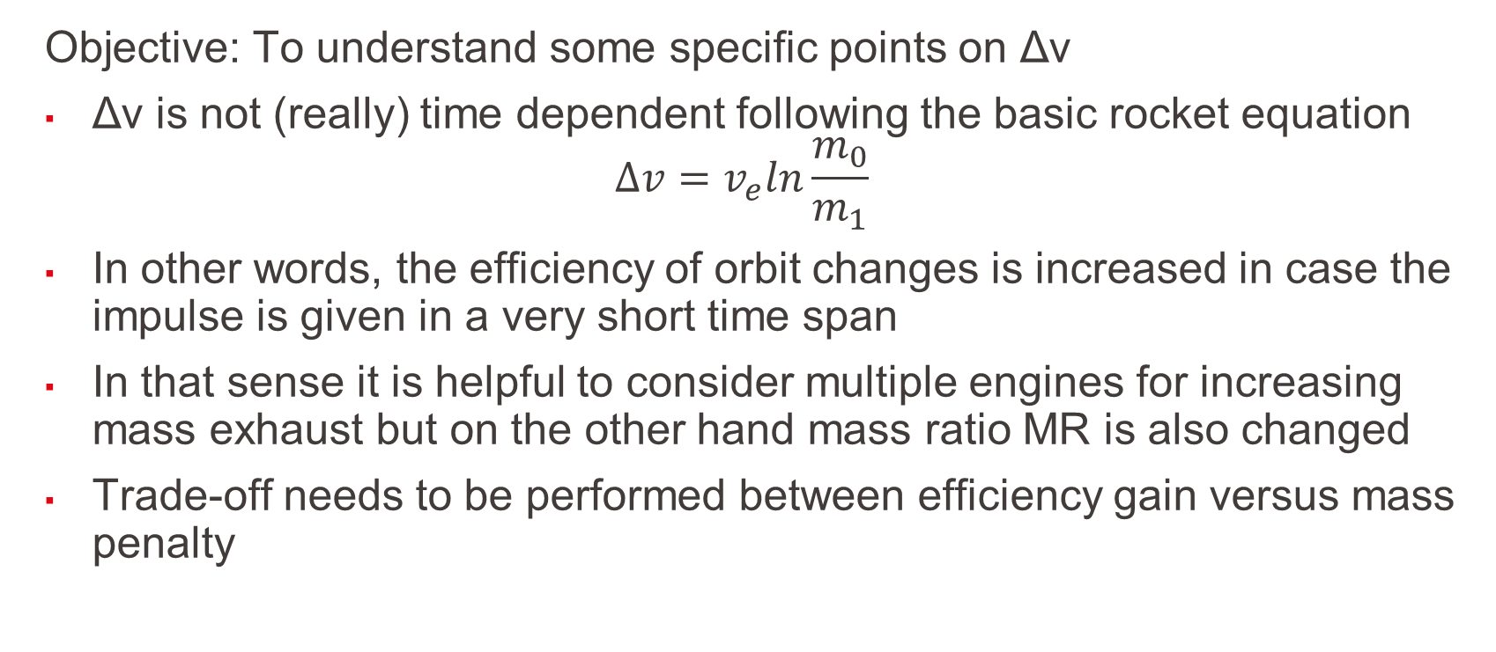
What is important on Δv?
Objective: To understand some specific points on Δv
Δv is not (really) time dependent following the basic rocket equation $∆v=v_{e}ln\frac{m_{0}}{m_{1}}$
In other words, the efficiency of orbit changes is increased in case the impulse is given in a very short time span
In that sense it is helpful to consider multiple engines for increasing mass exhaust but on the other hand mass ratio MR is also changed
Trade-off needs to be performed between efficiency gain versus mass penalty
L1 – Propulsion Systems
Space Propulsion ENG-510

Slide 24
What is important on Δv?
Objective: To understand some specific points on Δv
For same Δv need, the mass ratio (MR) between initial mass (dry mass + propellant mass) to final mass (dry mass) is smaller for higher exhaust velocity (v_{e}), i.e. efficiency is higher
100
v_{e} = 2 km / s
v_{e} = 4 km / s
L1 – Propulsion Systems
Space Propulsion ENG-510
MR [-]
10
v_{e} = 10 km / s
v_{e} = 30 km / s
1
0
20
0
5
10
15
Delta v [km / s]

Slide 25
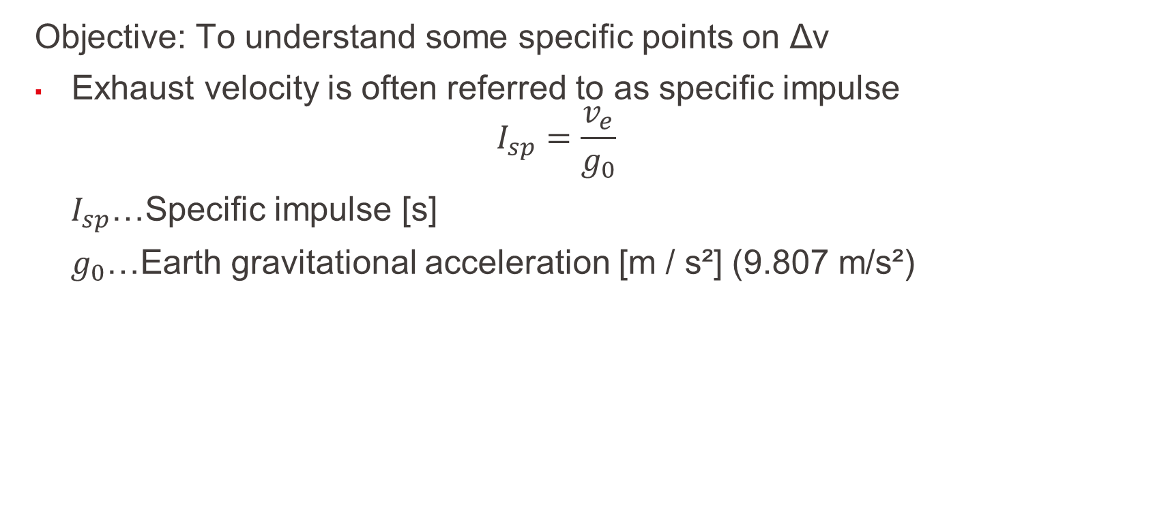
What is important on Δv?
Objective: To understand some specific points on Δv
Exhaust velocity is often referred to as specific impulse
$$I_{sp}=\frac{v_{e}}{g_{0}}$$
$I_{sp}$…Specific impulse [s]
$g_{0}$…Earth gravitational acceleration [m / s²] (9.807 m/s²)
L1 – Propulsion Systems
Space Propulsion ENG-510

Slide 26
What is important on Δv?
Objective: To understand some specific points on Δv
For given mass ratio (MR) between initial mass (dry mass + propellant mass) to final mass (dry mass), maximal achievable Δv is depending on the effective exhaust velocity (v_{e})
Necessary wet mass grows exponentially with the desired Δv
L1 – Propulsion Systems
Space Propulsion ENG-510
MR [-]
Delta v / v exhaust [-]

Slide 27
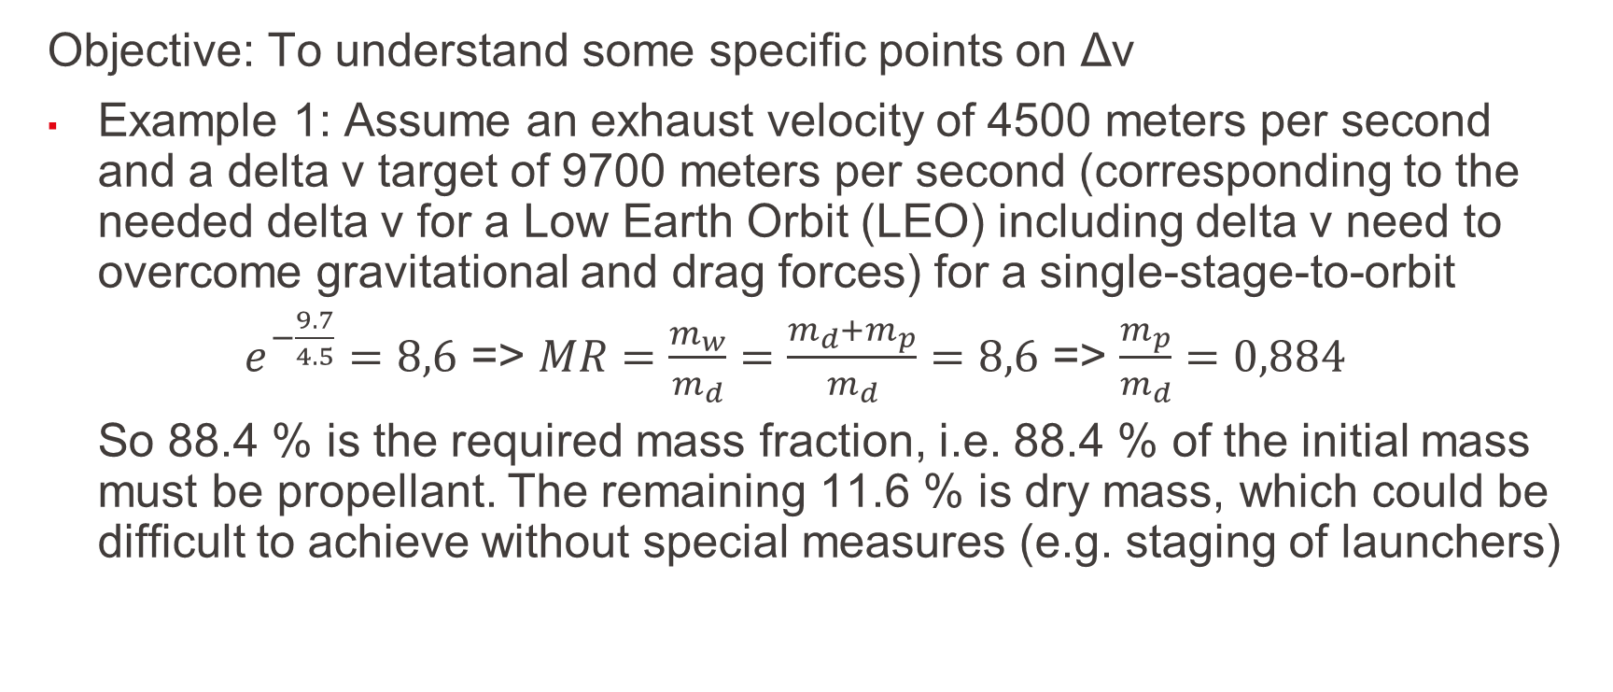
What is important on Δv?
Objective: To understand some specific points on Δv
Example 1: Assume an exhaust velocity of 4500 meters per second and a delta v target of 9700 meters per second (corresponding to the needed delta v for a Low Earth Orbit (LEO) including delta v need to overcome gravitational and drag forces) for a single-stage-to-orbit
$e^{−\frac{9.7}{4.5}}=8,6$ => $MR=\frac{m_{w}}{m_{d}}=\frac{m_{d}+m_{p}}{m_{d}}=8,6$ => $\frac{m_{p}}{m_{d}}=0,884$
So 88.4 % is the required mass fraction, i.e. 88.4 % of the initial mass must be propellant. The remaining 11.6 % is dry mass, which could be difficult to achieve without special measures (e.g. staging of launchers)
L1 – Propulsion Systems
Space Propulsion ENG-510

Slide 28
What is important on Δv?
Objective: To understand some specific points on Δv
Example 2: To achieve a delta v of 10 000 meters per second with an exhaust velocity of 2 000 meters per second a mass ratio of 147 is needed and so a required mass fraction of 99,3 %
L1 – Propulsion Systems
Space Propulsion ENG-510

Slide 29
What is important on Δv?
Objective: To understand some specific points on Δv
Δv is not only resulting from space propulsion systems
Δv is not only velocity change but also orbit change
Δv is not only linked to start point and end point only but also on the way between the two points (orbital trajectory)
Δv is not equal to velocity change
Δv is the same for deceleration and acceleration
L1 – Propulsion Systems
Space Propulsion ENG-510

Slide 30
What is important on Δv?
Objective: To understand some specific points on Δv
Δv is not only linked to start point and end point only but also on the way between the two points (orbital trajectory)
Two main different trajectories are discussed hereafter (not considering any change of inclination for simplification [inclination is the angular distance of the orbital plane from the plane of the planet's equator, stated in degrees])
L1 – Propulsion Systems
Space Propulsion ENG-510

Slide 31
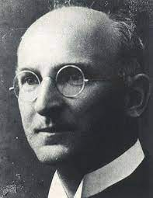
What is important on Δv?
Objective: To understand some specific points on Δv
Two classical orbital changes must be known
Hohmann transfer (impulsive maneuver – two short impulses)
Edelbaum transfer (long duration maneuver with low thrust – spiral orbit raising)
L1 – Propulsion Systems
Hohmann Transfer
Edelbaum Transfer
Space Propulsion ENG-510

Slide 32
What is important on Δv?
Objective: To understand some specific points on Δv
Hohmann transfer is a two-impulse orbit transfer
Acceleration in a period sufficiently smaller than the orbital period
Basic maneuver in chemical propulsion
Transfer from perigee (point close to Earth) to apogee (point far from Earth) on an elliptical trajectory
L1 – Propulsion Systems
Space Propulsion ENG-510

Slide 33

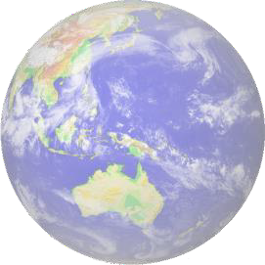


What is important on Δv?
Objective: To understand some specific points on Δv
Δv need for a Hohmann transfer is determined by (as derived from the vis-viva-equation considering instantaneous impulses): $Δv_{1}=\sqrt{\frac{μ}{r_{1}}}\left(\sqrt{\frac{2r_{2}}{r_{1}+r_{2}}}−1\right)$ $Δv_{2}=\sqrt{\frac{μ}{r_{2}}}\left(1−\sqrt{\frac{2r_{1}}{r_{1}+r_{2}}}\right)$ $Δv_{tot}=Δv_{1}$+ $Δv_{2}$
L1 – Propulsion Systems
Space Propulsion ENG-510
Perigee
Apogee

Slide 34
What is important on Δv?
Objective: To understand some specific points on Δv
Example: Δv need for a geostationary transfer considering the Hohmann transfer beginning at r₁ = 6 678 km (altitude 300 km) and ending in a geostationary Earth orbit with r₂ = 42 164 km (altitude 35 786 km)
In the smaller circular orbit, the speed is 7.73 km / s; in the larger one, 3.07 km / s. In the elliptical orbit in between the speed varies from 10.15 km / s at the perigee to 1.61 km / s at the apogee
Therefore, the Δv for the first burn is 10.15 − 7.73 = 2.42 km / s, for the second burn 3.07 − 1.61 = 1.46 km / s, and for both together the total Δv is 3.88 km / s
L1 – Propulsion Systems
Space Propulsion ENG-510

Slide 35
What is important on Δv?
Objective: To understand some specific points on Δv
Spiral orbit raising is a continuous thrust orbit transfer
Basic maneuvers in electric propulsion (Assumptions: tangential thrust, constant thrust and velocity = circular orbit velocity at its radius
L1 – Propulsion Systems
Space Propulsion ENG-510

Slide 36
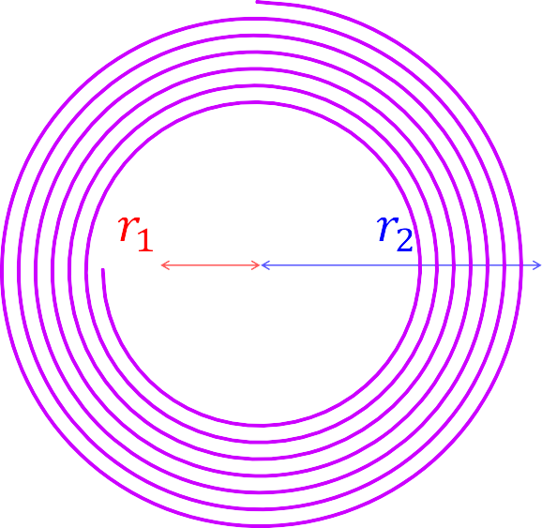

What is important on Δv?
Objective: To understand some specific points on Δv
Δv need for an Edelbaum transfer (spiral orbit raising) is determined by the following equations: $Δv_{1}=\sqrt{\frac{μ}{r_{1}}}$ $Δv_{2}=\sqrt{\frac{μ}{r_{2}}}$ $Δv_{tot}=Δv_{1}−$ $Δv_{2}$
L1 – Propulsion Systems
Space Propulsion ENG-510
Perigee
Apogee

Slide 37
What is important on Δv?
Objective: To understand some specific points on Δv
Example: Δv need for a geostationary transfer considering the Edelbaum transfer beginning at r₁ = 6 678 km (altitude 300 km) and ending in a geostationary Earth orbit with r₂ = 42 164 km (altitude 35 786 km)
In the smaller circular orbit the speed is 7.73 km / s; in the larger one, 3.07 km / s
Therefore the total Δv need for an Edelbaum transfer is 7.73 − 3.07 = 4.66 km / s, so higher compared to a Hohmann transfer requiring a total Δv of 3.88 km / s
L1 – Propulsion Systems
Space Propulsion ENG-510

Slide 38
What is important on Δv?
Objective: To understand some specific points on Δv
Hohmann transfer versus spiral orbit raising
Hohmann transfer is much faster
Hohmann transfer requires high thrust
Δv increase is higher for spiral orbit raising
L1 – Propulsion Systems
Space Propulsion ENG-510

Slide 39
What is important on Δv?
Objective: To understand some specific points on Δv
Δv is not only resulting from space propulsion systems
Δv is not only velocity change but also orbit change
Δv is not only linked to start point and end point only but also on the way between the two points (orbital trajectory)
Δv is not equal to velocity change
Δv is the same for deceleration and acceleration
L1 – Propulsion Systems
Space Propulsion ENG-510

Slide 40
What is important on Δv?
Objective: To understand some specific points on Δv
Δv is not equal to velocity change
Δv and actual velocity depend on the orbit like for LEO (ℎ = 420 km, 𝑣 = 7.66 km/s)
Assuming continuous thrust in the direction of acceleration
Altitude will increase, but “velocity” will decrease in this circular orbit raise (ℎ = 620 km, 𝑣 = 7.55 km/s)
Also as stated before, Energy will increase
L1 – Propulsion Systems
Space Propulsion ENG-510

Slide 41
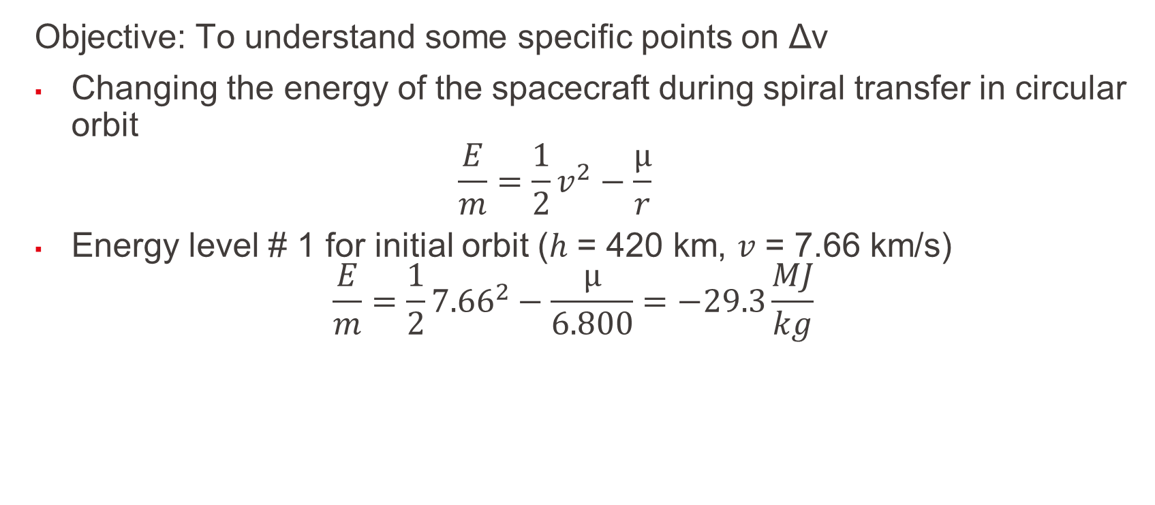
What is important on Δv?
Objective: To understand some specific points on Δv
Changing the energy of the spacecraft during spiral transfer in circular orbit $\frac{E}{m}=\frac{1}{2}v^{2}−\frac{μ}{r}$
Energy level # 1 for initial orbit (ℎ = 420 km, 𝑣 = 7.66 km/s) $\frac{E}{m}=\frac{1}{2}{7.66}^{2}−\frac{μ}{6.800}=−29.3\frac{MJ}{kg}$
L1 – Propulsion Systems
Space Propulsion ENG-510

Slide 42
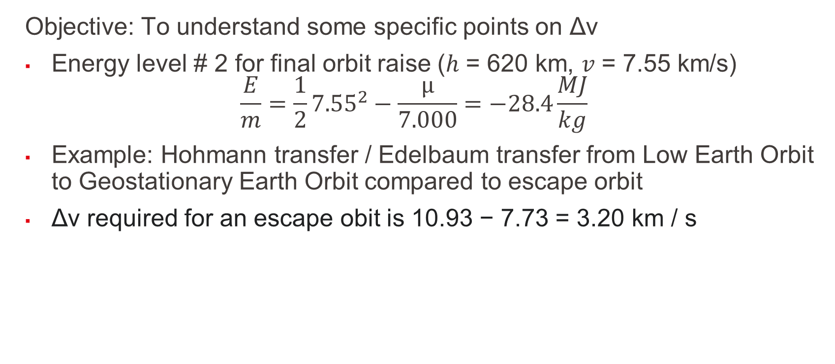
What is important on Δv?
Objective: To understand some specific points on Δv
Energy level # 2 for final orbit raise (ℎ = 620 km, 𝑣 = 7.55 km/s) $\frac{E}{m}=\frac{1}{2}{7.55}^{2}−\frac{μ}{7.000}=−28.4\frac{MJ}{kg}$
Example: Hohmann transfer / Edelbaum transfer from Low Earth Orbit to Geostationary Earth Orbit compared to escape orbit
Δv required for an escape obit is 10.93 − 7.73 = 3.20 km / s
L1 – Propulsion Systems
Space Propulsion ENG-510

Slide 43
What is important on Δv?
Objective: To understand some specific points on Δv
Applying a Δv at LEO of only 0.78 km / s more (3.20 − 2.42) would give the rocket the escape velocity, which is less than the Δv of 1.46 km / s required to circularize the geosynchronous orbit
This illustrates the Oberth effect, that at large speeds the same Δv provides more specific orbital energy, and energy increase is maximized if one spends the Δv as quickly as possible, rather than spending some, being decelerated by gravity, and then spending some more to overcome the deceleration
L1 – Propulsion Systems
Space Propulsion ENG-510

Slide 44
What is important on Δv?
Objective: To understand some specific points on Δv
Δv is not only resulting from space propulsion systems
Δv is not only velocity change but also orbit change
Δv is not only linked to start point and end point only but also on the way between the two points (orbital trajectory)
Δv is not equal to velocity change
Δv is the same for deceleration and acceleration
L1 – Propulsion Systems
Space Propulsion ENG-510

Slide 45
What is important on Δv?
Objective: To understand some specific points on Δv
Δv is the same for deceleration and acceleration
Δv is the same going from LEO to GEO or from GEO to LEO
One transfer is only supported by acceleration whereas the other one is referring to deceleration
L1 – Propulsion Systems
Space Propulsion ENG-510

Slide 46
What is important on Δv?
Objective: To understand some specific points on Δv
Δv is the same for deceleration and acceleration
One can reach Mars by escaping the Earth with Δv of + 2.9 km / s
L1 – Propulsion Systems
Space Propulsion ENG-510

Slide 47
What is important on Δv?
Objective: To understand some specific points on Δv
One can reach Venus by escaping the Earth with Δv of - 2.5 km / s as a deceleration maneuver
Deceleration is not easy at all, but completely same effort is needed as for acceleration (while traveling on the Earth we do have already a certain velocity…)
L1 – Propulsion Systems
Space Propulsion ENG-510

Slide 48
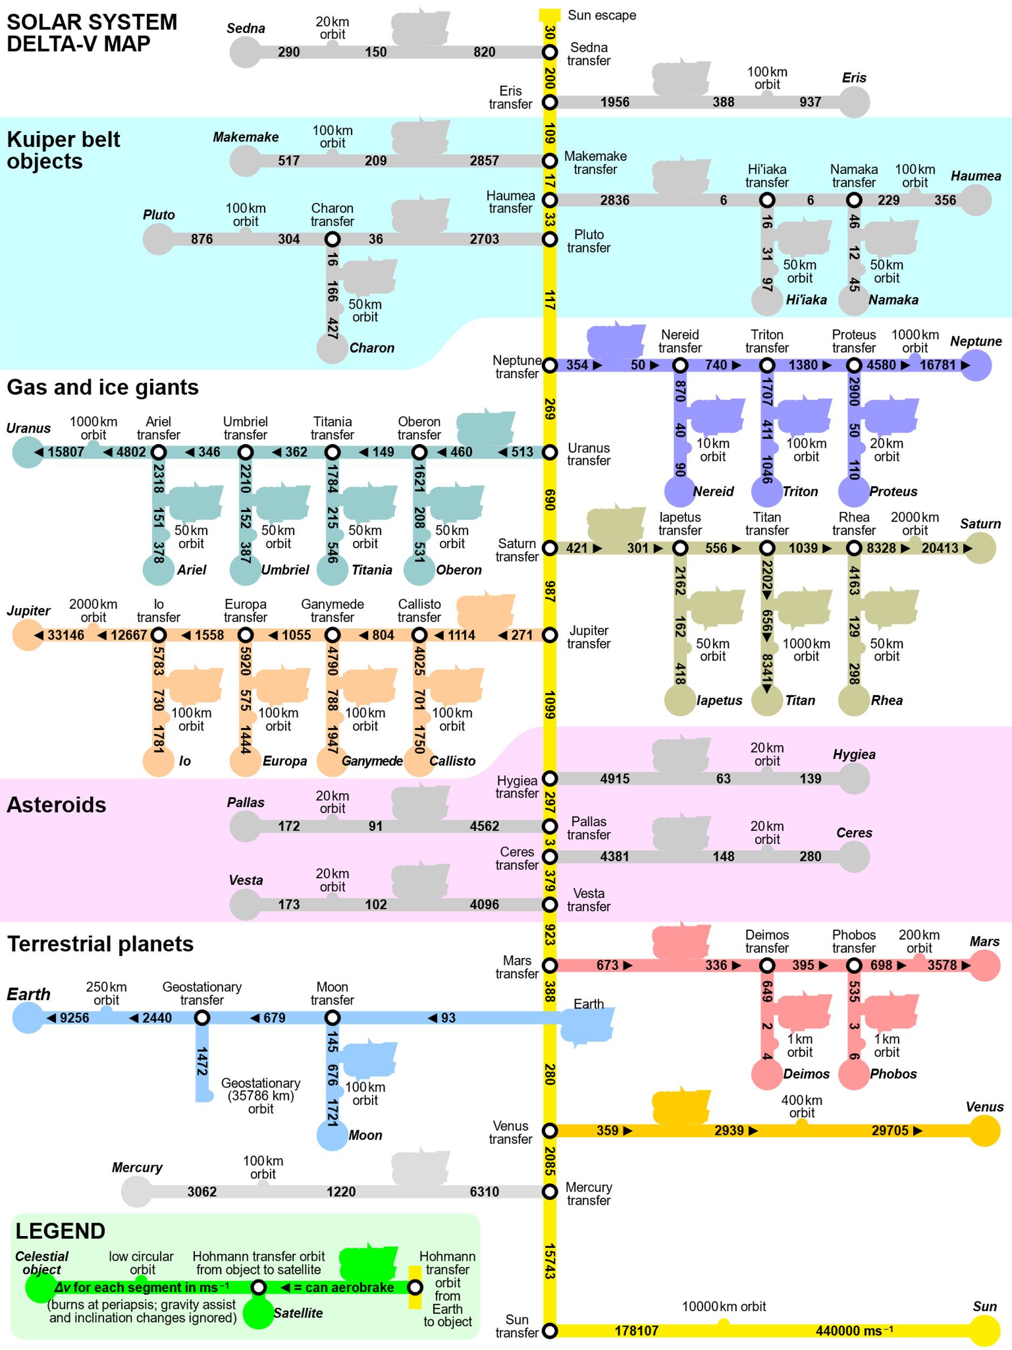
What is important on Δv?
L1 – Propulsion Systems
Space Propulsion ENG-510

Slide 49
What is important on Δv?
Objective: To understand some specific points on Δv
Δv is key parameter for understanding of space journeys, but
Δv is not the only parameter…
L1 – Propulsion Systems
Space Propulsion ENG-510

Slide 50
What is the importance of thrust?
Objective: To discuss thrust + relation to Isp
How thrust is produced?
How efficiently thrust can be produced?
How thrust and thrust efficiency affect the vehicle mass in terms of:
Propellant mass?
Inert mass required to hold the propellant and provide the thrust?
Some key topics related to thrust:
Launcher versus Satellite propulsion
Thrust level on ground
Minimization of propellant mass and therefore maximizing of c (efficiency)
L1 – Propulsion Systems
Space Propulsion ENG-510

Slide 51
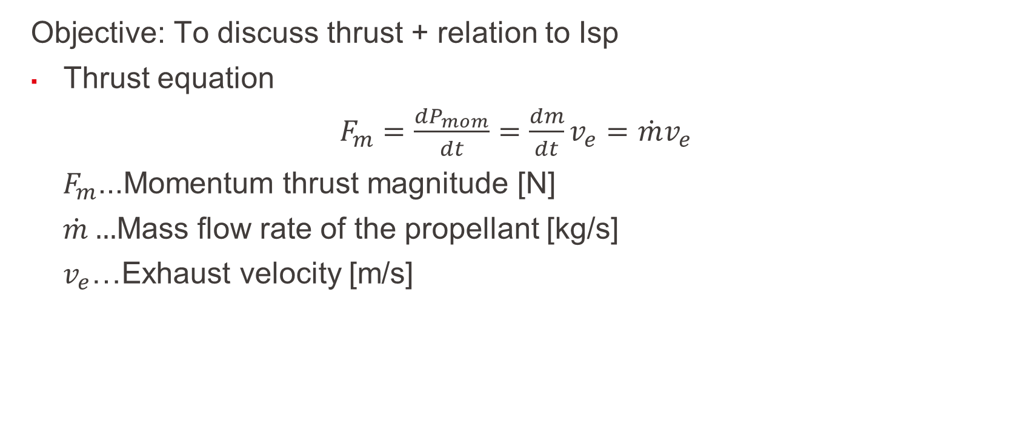
What is the importance of thrust?
Objective: To discuss thrust + relation to Isp
Thrust equation
$F_{m}=\frac{dP_{mom}}{dt}=\frac{dm}{dt}v_{e}=$ ${\dot{m}v}_{e}$
$F_{m}$...Momentum thrust magnitude [N]
$\dot{m}…$Mass flow rate of the propellant [kg/s]
$v_{e}$…Exhaust velocity [m/s]
L1 – Propulsion Systems
Space Propulsion ENG-510

Slide 52
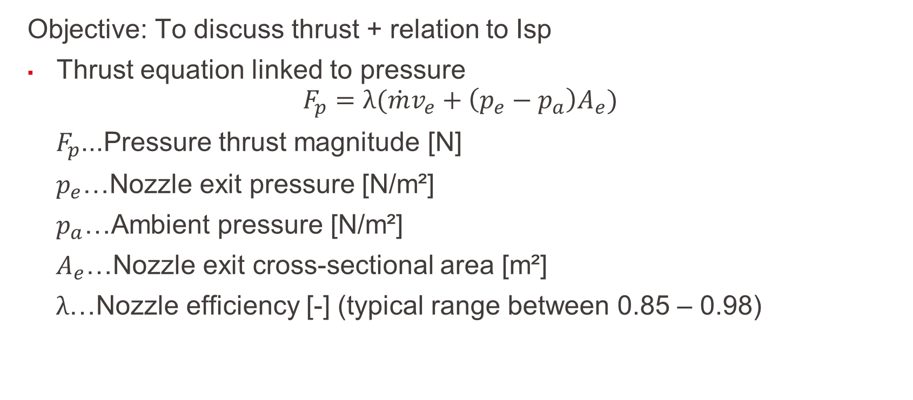
What is the importance of thrust?
Objective: To discuss thrust + relation to Isp
Thrust equation linked to pressure
$$F_{p}=λ({\dot{m}v}_{e}+\left(p_{e}−p_{a}\right)A_{e})$$
$F_{p}$...Pressure thrust magnitude [N]
$p_{e}$…Nozzle exit pressure [N/m²]
$p_{a}$…Ambient pressure [N/m²]
$A_{e}$…Nozzle exit cross-sectional area [m²]
$λ$…Nozzle efficiency [-] (typical range between 0.85 – 0.98)
L1 – Propulsion Systems
Space Propulsion ENG-510

Slide 53
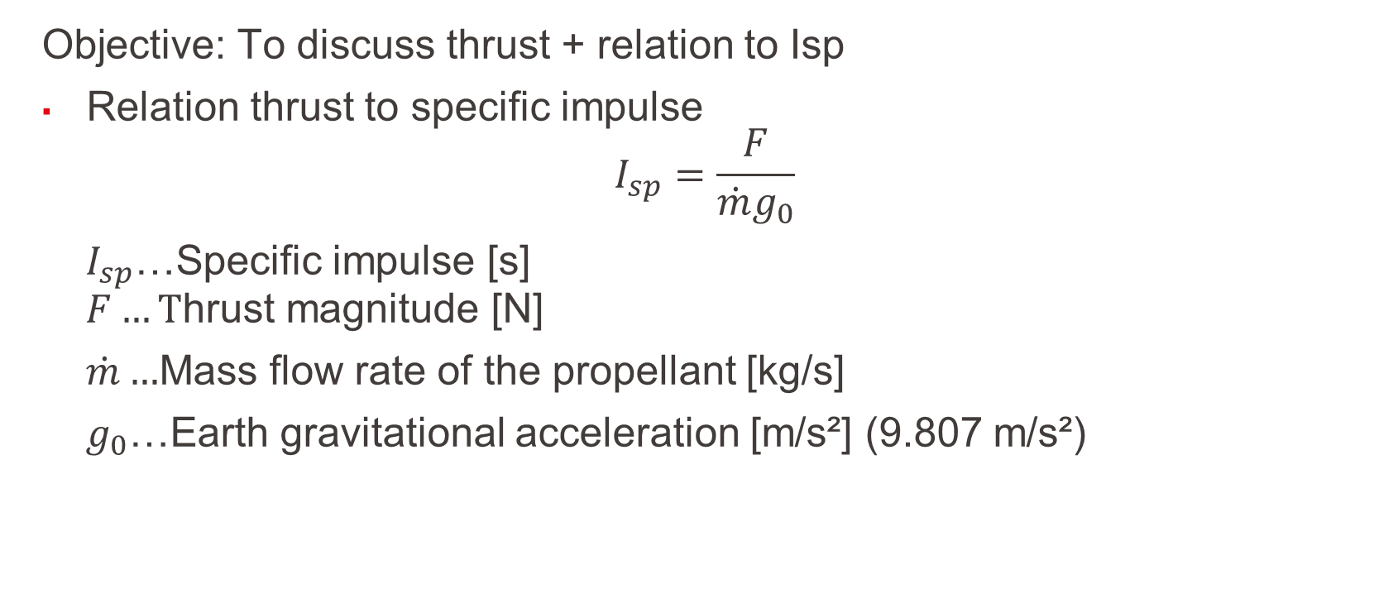
What is the importance of thrust?
Objective: To discuss thrust + relation to Isp
Relation thrust to specific impulse
$$I_{sp}=\frac{F}{{\dot{m}g}_{0}}$$
$I_{sp}$…Specific impulse [s]
$$F…T\text{hrust} \text{magnitude}\text{ [}\text{N}\text{] }$$
$\dot{m}…$Mass flow rate of the propellant [kg/s]
$g_{0}$…Earth gravitational acceleration [m/s²] (9.807 m/s²)
L1 – Propulsion Systems
Space Propulsion ENG-510

Slide 54

What is the importance of thrust?
Objective: To discuss thrust + relation to Isp
Effective exhaust velocity
$c=v_{e}+$ $\frac{\left(p_{e}−p_{a}\right)A_{e}}{\dot{m}}$
$c$…Effective exhaust velocity [m/s]
$$F_{m}=\dot{m}c$$
$$c=I_{sp}g_{0}$$
L1 – Propulsion Systems
Space Propulsion ENG-510

Slide 55
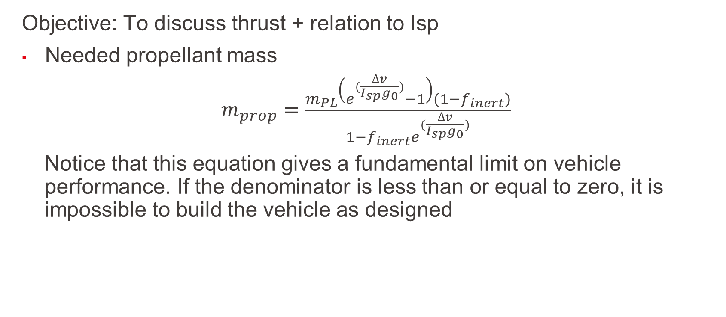
What is the importance of thrust?
Objective: To discuss thrust + relation to Isp
Needed propellant mass
$m_{prop}=$ $\frac{m_{PL}\left(e^{(\frac{∆v}{I_{sp}g_{0}})}−1\right)(1−f_{inert})}{1−f_{inert}e^{(\frac{∆v}{I_{sp}g_{0}})}}$
Notice that this equation gives a fundamental limit on vehicle performance. If the denominator is less than or equal to zero, it is impossible to build the vehicle as designed
L1 – Propulsion Systems
Space Propulsion ENG-510

Slide 56
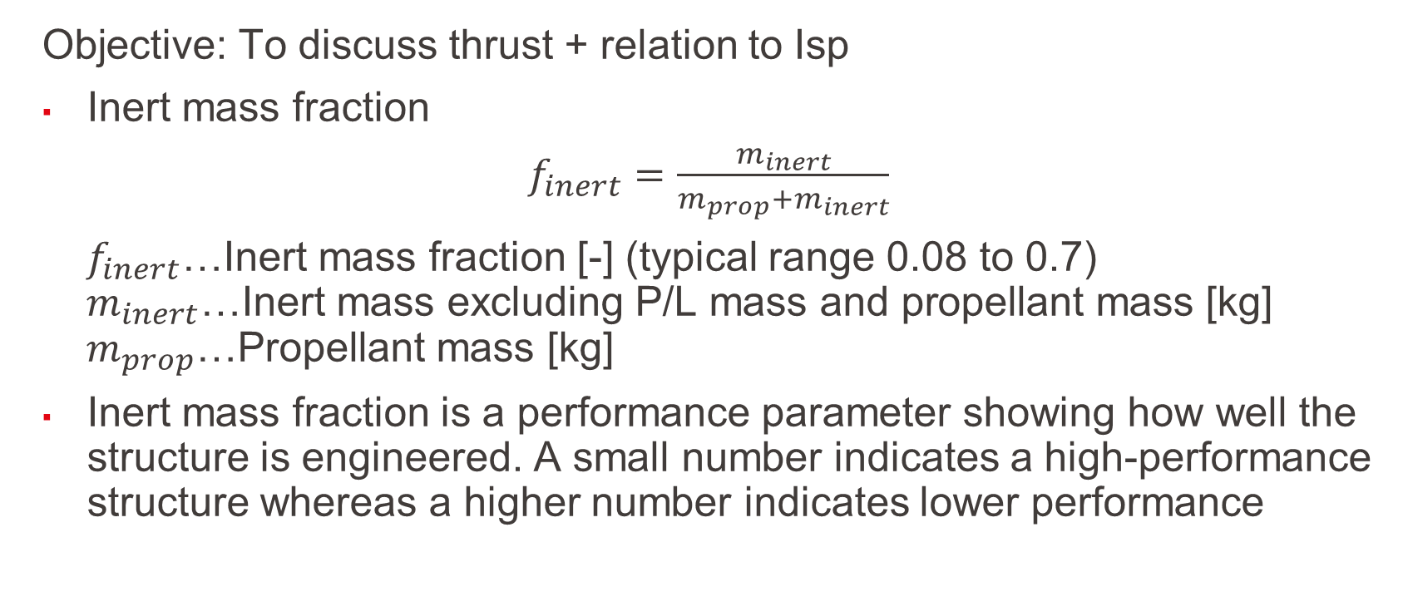
What is the importance of thrust?
Objective: To discuss thrust + relation to Isp
Inert mass fraction
$f_{inert}=$ $\frac{m_{inert}}{m_{prop}+m_{inert}}$
$f_{inert}$…Inert mass fraction [-] (typical range 0.08 to 0.7)
$$m_{inert}\text{…}\text{Inert} \text{mass} \text{excluding} \text{P}\text{/}\text{L} \text{mass} \text{and} \text{propellant} \text{mass} \text{[}\text{kg}\text{]}$$
$$m_{prop}\text{…}\text{P}\text{ropellant} \text{mass} \text{[}\text{kg}\text{]}$$
Inert mass fraction is a performance parameter showing how well the structure is engineered. A small number indicates a high-performance structure whereas a higher number indicates lower performance
L1 – Propulsion Systems
Space Propulsion ENG-510

Slide 57
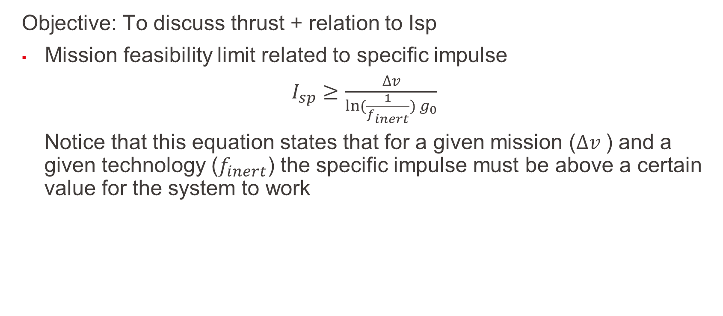
What is the importance of thrust?
Objective: To discuss thrust + relation to Isp
Mission feasibility limit related to specific impulse
$I_{sp}≥$ $\frac{∆v}{ln⁡(\frac{1}{f_{inert}}) g_{0}}$
Notice that this equation states that for a given mission ($∆v$) and a given technology ($f_{inert}$) the specific impulse must be above a certain value for the system to work
L1 – Propulsion Systems
Space Propulsion ENG-510

Slide 58
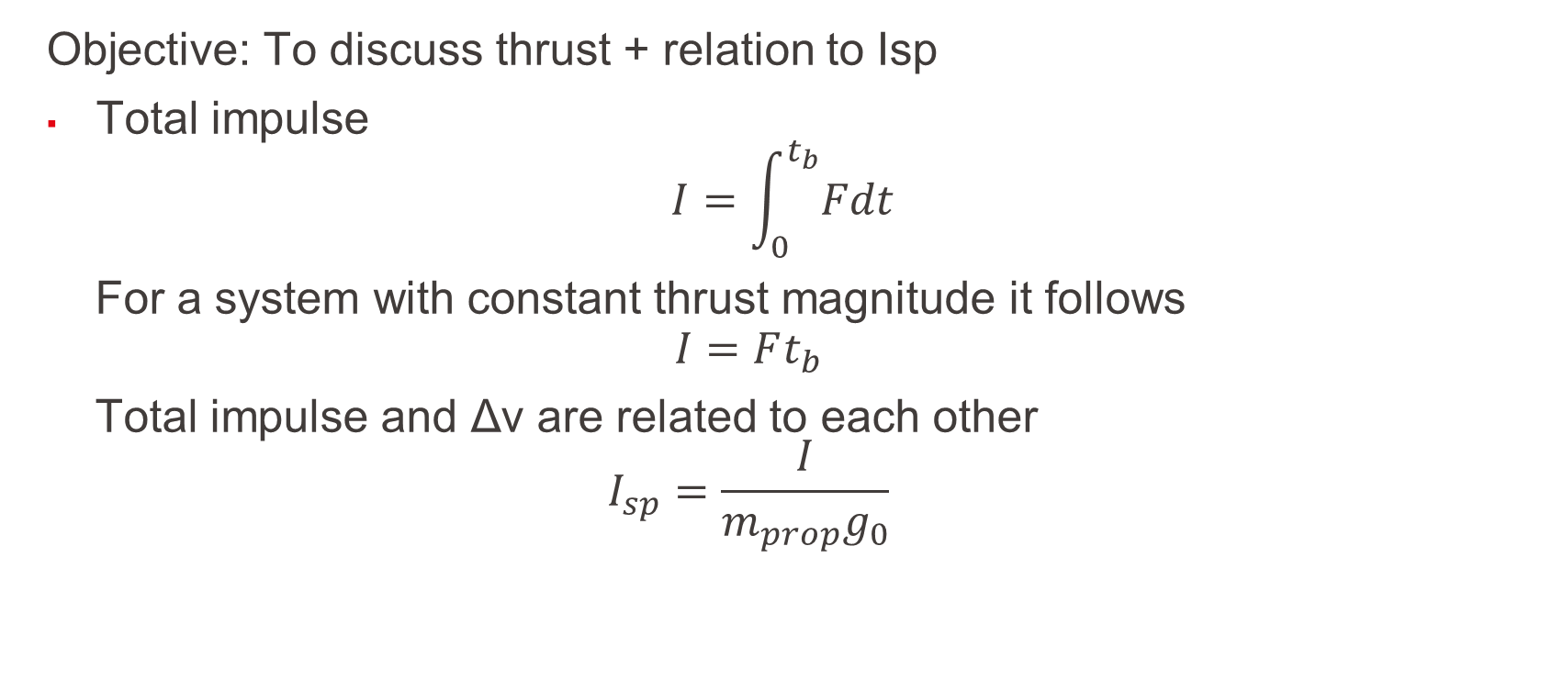
What is the importance of thrust?
Objective: To discuss thrust + relation to Isp
Total impulse
$$I=\int_{0}^{t_{b}}{Fdt}$$
For a system with constant thrust magnitude it follows
$$I=Ft_{b}$$
Total impulse and Δv are related to each other $$I_{sp}=\frac{I}{m_{prop}g_{0}}$$
L1 – Propulsion Systems
Space Propulsion ENG-510

Slide 59
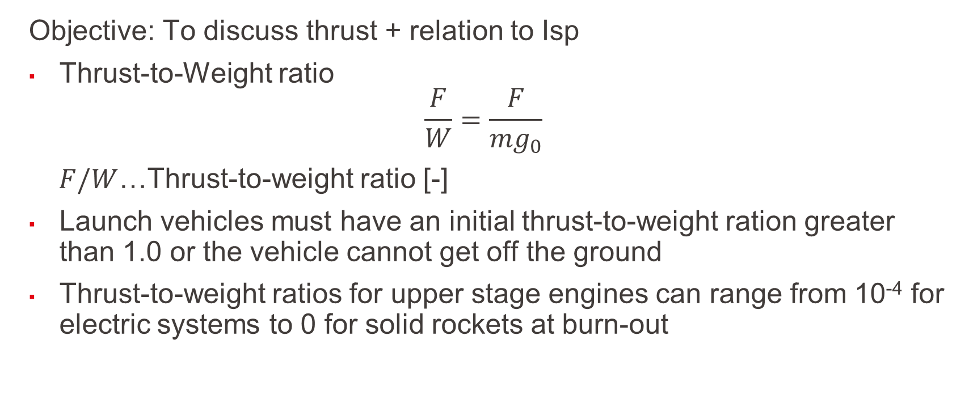
What is the importance of thrust?
Objective: To discuss thrust + relation to Isp
Thrust-to-Weight ratio
$$\frac{F}{W}=\frac{F}{{mg}_{0}}$$
$F/W$…Thrust-to-weight ratio [-]
Launch vehicles must have an initial thrust-to-weight ration greater than 1.0 or the vehicle cannot get off the ground
Thrust-to-weight ratios for upper stage engines can range from 10⁻⁴ for electric systems to 0 for solid rockets at burn-out
L1 – Propulsion Systems
Space Propulsion ENG-510

Slide 60
What is the importance of thrust?
Engine | Launcher | Propellant | Exhaust Velocity | Thrust
F1 | Saturn V | LOx / RP-1 | 3.0 km / s | 7.7 MN
RD-107 | Soyuz | LOx / RP-1 | 3.1 km / s | 1.0 MN
RD-264 | Dnepr | NTO / UDMH | 3.2 km / s | 4.5 MN
SSME | Shuttle | LOx / LH2 | 4.5 km / s | 2.2 MN
LE7A | H2A | LOx / LH2 | 4.3 km / s | 1.1 MN
Vulcain 2 | Ariane 5 | LOx / LH2 | 4.3 km / s | 1.3 MN
SSRB | Shuttle | Composite | 2.7 km / s | 13.8 MN
SRB-A | H2A | Composite | 2.8 km / s | 2.3 MN
M-V-1 | M-V | Composite | 2.8 km / s | 2.4 MN
Objective: To discuss thrust + relation to Isp
How thrust is produced?
How efficiently thrust can be produced?
How thrust and thrust efficiency affect the vehicle mass in terms of:
Propellant mass?
Inert mass required to hold the propellant and provide the thrust?
Some key topics related to thrust:
Launcher versus Satellite propulsion
Thrust level on ground
Minimization of propellant mass and therefore maximizing of c (efficiency)
L1 – Propulsion Systems
Space Propulsion ENG-510

